Slide 1
CS 120 Extra: Javascript Coding
Tarik Booker
CS 120
California State University, Los Angeles

Slide 2
Topics
Quick Review
The Document Object Model (DOM)
Types of Javascript
Programming in Javascript
Variables
Functions
Interfaces

Slide 3
Quick Review
HTML
Structured information
CSS
Display and presentation
Javascript
Functionality and dynamics

Slide 4
Why Javascript?
HTML pages with CSS are static
They don’t move (much) after they load
Hover / Rollovers
Best things you have
Javascript allows movement and changes to elements after page load

Slide 5
Types of Javascript
Internal
External
Inline
Only similar to CSS

Slide 6
Internal Javascript
Requires SCRIPT element
Can include “MIME” type
<script type = “text/javascript”>
Default is javascript
Allowed within both HEAD and BODY tags
Can include multiple instances through a page
Depending upon where you insert the SCRIPT tag, the javascript may show up

Slide 7
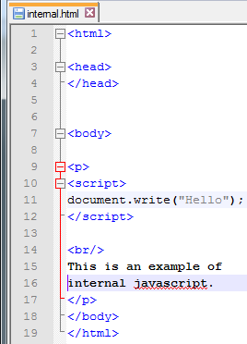
Internal Javascript (2)
Example:
Inside the <p> tag (line 9)
Script element within (lines 10-12)
Calling a javascript function that writes to the screen (document.write)
Occurs within the HTML file
When the page loads (runs), the function will execute.
(Note: if printing text, use double quotes)
What will this display?

Slide 8
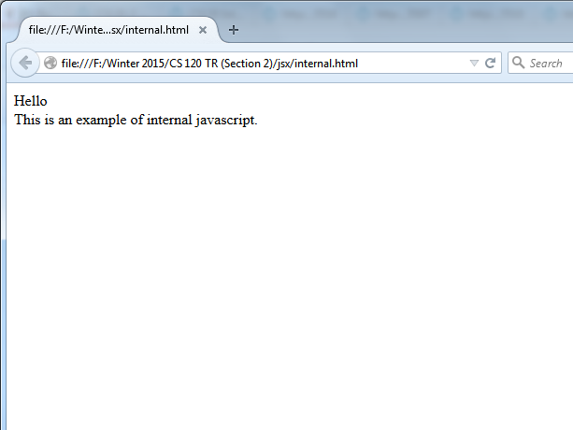
Internal Javascript (3)
The contents of the document.write function displays the text just as though it was written directly in the HTML!
We will come back to this later…

Slide 9
External Javascript
Takes an external javascript file and loads the code contained within
You can move your Javascript code outside (externally to) the page
Uses SCRIPT tag, but requires SRC attribute
Requires an end tag!!!!!!
Do not put any content within the tags
<script src=“ext.js”>
</script>

Slide 10
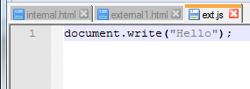
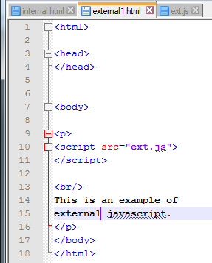
External Javascript (2)
Example:
Our document.write function is in the external javascript file (ext.js)
The file that contains the code is imported into our html file (external.html)
What will this display?

Slide 11
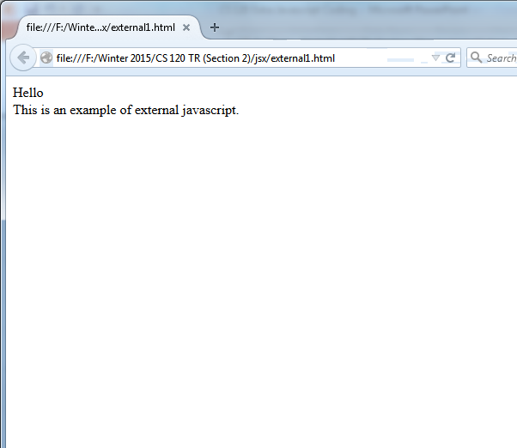
External Javascript (3)
The javascript code executed as though it were included in the file!

Slide 12
Multiple Script Tags
You can have multiple SCRIPT tags within an HTML document.
Different from CSS
The code executes whenever “called”

Slide 13
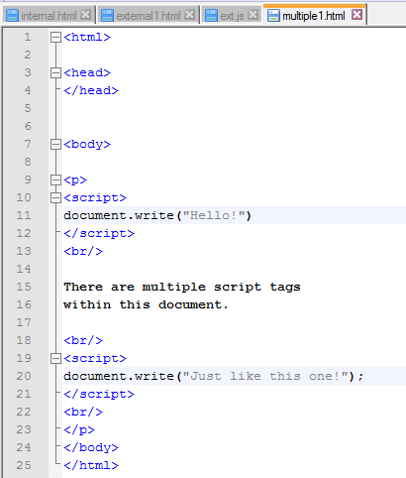
Multiple Script Tags (2)
Example:
Multiple script tags within document
Everything here is within a <p> tag
Any legal HTML is fine
(Note the breaks (<br>) within the document.)
What will this display?

Slide 14
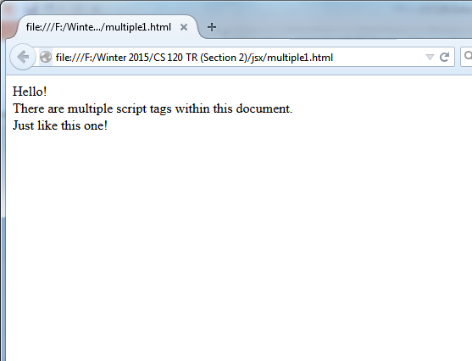
Multiple Script Tags (3)
Each script executes in order.
Let’s see the external version!

Slide 15
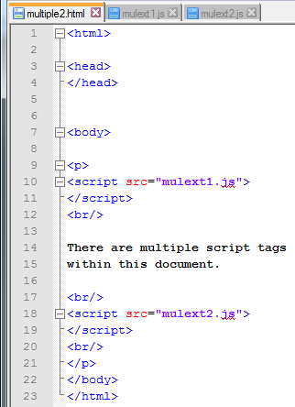
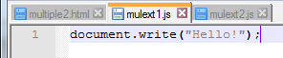
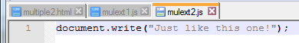
Multiple Script Tags (4)
Multiple Externals
What will this display?

Slide 16
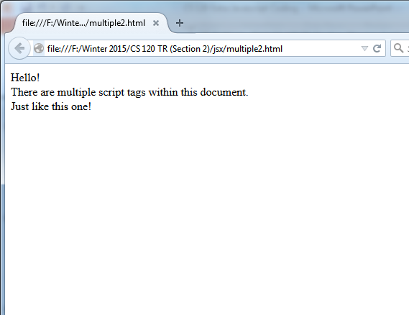
Multiple Script Tags (5)
I think you now understand.

Slide 17
Inline Javascript
I will come back to this subject
Right now, understand that inline javascript is written in “events”
We will discuss this later…

Slide 18
Javascript Commands
Javascript code is written as a set of commands
Statements that instruct the computer to do something.
Many different types of commands
Declarations
Conditionals
Functions
Loops
Variable initializations
(Only covering declarations, functions, and variables)

Slide 19
Javascript Commands (2)
To write a javascript command, input the command name and write a semicolon (;)
Ex: This command “calls” a built in function (you’ve seen it before):
document.write(“Hello”);
document.writeln(“This adds a line after the text”);
Use semicolons after every javascript command
Unless otherwise noted (later)

Slide 20
Javascript Functions
In this class, we primarily use built in javascript functions
These are built-in sets of commands perform an operation
Format: function_name(arguments);
Note: Some functions don’t have arguments!
Run them by just typing: function_name();
What’s the function we have been using?
document.write(text);
This takes in text as an argument, and writes it to the page like HTML

Slide 21
Javascript Functions (2)
There are many, many many different built-in functions in javascript
Examples:
document.write(text) Writes the text to the page
Document.writeln(text) Writes text then adds a break
Window.alert(text) Shows a popup window
Window.showModalDialog(url) A popup for the url
We will discuss more functions later…

Slide 22
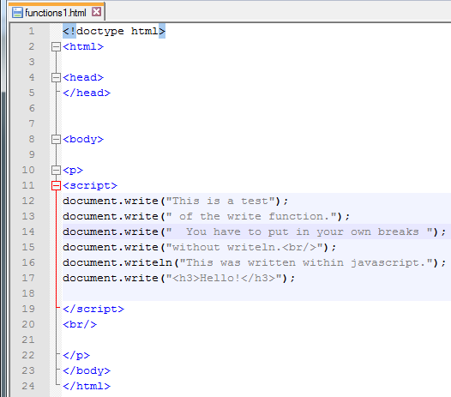
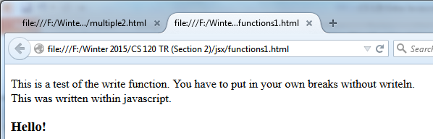
Javascript Functions (3)
The document.write function writes text (HTML) to the screen.

Slide 23
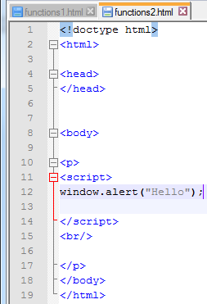
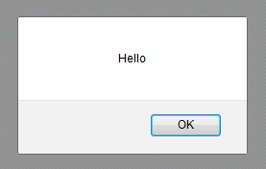
Javascript Functions (4)
This function displays a popup box with the text inside.

Slide 24
Javascript Variables
In javascript, you can temporarily store a value.
Called a “variable”
(Think math)
This variable will be useful later…
Use the var keyword

Slide 25
Javascript Variables (2)
Declaring a variable:
Just write: var [variable_name];
You can assign a value to the variable by setting it equal to something.
Ex:
var variable1;
variable1 = 10;
We can then use that variable name in place of the value!

Slide 26
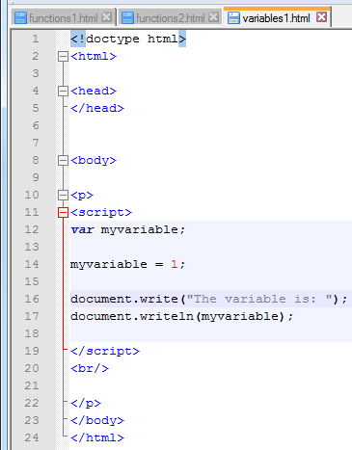
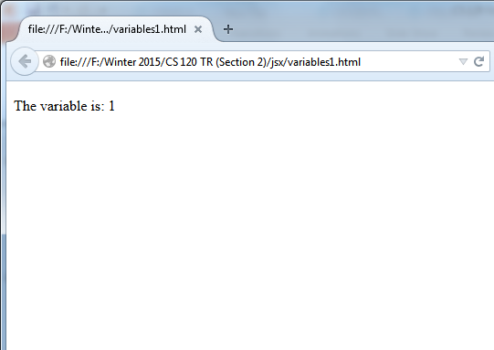
Javascript Variables (3)
Note: In javascript, more than just numbers can be stored in a variable! We will discuss this later…

Slide 27
Passing a Variable to a Function
Note in the last example, the variable myvariable was placed between the parentheses of the document.writeln function.
Called passing a value to a function.
The function executes based on the input of the function (the value of the variable).
We have been doing this with actual values
For write and writeln, they require text (called a string)

Slide 28
Writing your own functions
You can write your own functions!
Functions are simply a list of commands that execute all at once.
Syntax:
function [function_name](argument)
{
Commands…;
}
Define a function by writing the keyword function, your (own) function name, then the arguments it takes
If no arguments, just write ()
Note: There are no semicolons after the function definition!

Slide 29
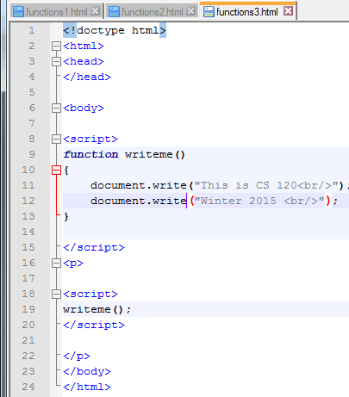
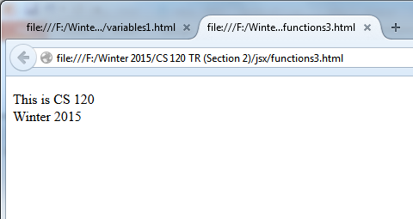
Writing your own functions (2)
Example: the writeme function
Writes class information

Slide 30
Writing your own functions (3)
Notice that the function only operates when I call it.
Function is defined at lines 9-13
Function is executed at line 19

Slide 31
Writing your own functions (4)
If you want to utilize an argument, the argument name becomes like a variable during the function!
I can access and change the argument name like any variable
Variable is removed after the function concludes

Slide 32
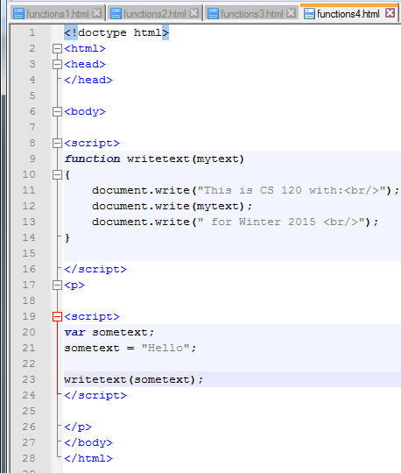
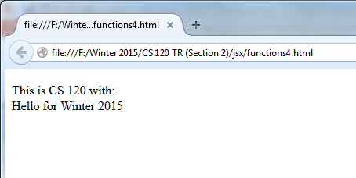
Writing your own functions (5)
Example: The write text function.
The value “Hello” is passed into the function writetext at line 23.
This is taken from function writetext and passed into argument mytext at line 9.
Variable mytext contains the value “Hello”

Slide 33
Writing your own functions (6)
Note that in the writeme and writetext functions, the document.write function is called.
You can always call functions within other functions.

Slide 34
The Document Object Model
Before now, you’ve considered elements simply markup, something to add around text (or include media)
Now consider a different paradigm, the Document Object Model!
Called the DOM

Slide 35
Document Object Model (2)
The DOM considers all elements in your HTML document to be an object, an abstract item floating about the document

Slide 36
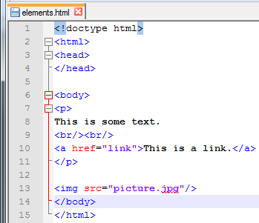
Document Object Model (3)
Code
DOM
HTML
HEAD
Body
p
The p tag is within the body tag
The a tag is within the p tag
The img tag is within the body tag
a
The p object is within the body object
The a object is within the p object
The img object is within the body object
img

Slide 37
Document Object Model (4)
You can now access the elements in a different way.
This is how javascript “sees” the elements in a page (through the DOM)
Whatever object you want, you can access it and change it (based on what it is).
Works for all elements
Document – for the (written) page
Window – what you see

Slide 38
Attributes through the DOM
If you want to select attributes through the DOM, you have to access them like objects
Use the dot (“.”) operator
If you know an element has an attribute, simply access that attribute using:
element.attribute
(element “dot” attribute)
This allows you to treat the attribute like a variable!
This methodology is referred to as a programming interface

Slide 39
Attributes through the DOM (2)
Note: Every element contains two special attributes (accessible through the DOM)
title
The title of the element (tooltip)
innerHTML
All the HTML that is contained between the start and end tags
(Of course not for single self-closing tags.)
We will come back to these later…

Slide 40
Attributes through the DOM (3)
The DOM also has special objects
Document
You’ve seen this earlier
Contains attributes of its own
Also contains functions (write)
Window
Contains special functions
Pop up windows
Use the dot (“.”) operator to access these functions and attributes
document.write(text);
Note: window is the “default object” so to call its functions, doesn’t require the dot operator
alert(text); (Really should be window.alert(text);)

Slide 41
Accessing and Changing Elements
How do I access elements?
There is a special function within the document object.
getElementById(id)
You can access this function with the dot operator:
document.getElementById(id)
Give a particular element a unique id name (using id attribute) in the HTML
Pass that name to the getElementById function to access the element

Slide 42
Accessing and Changing Elements (2)
How do I store the element?
Set the results of document.getElementById(id) equal to a variable
Called a “handle”
The variable now stores a “reference” to the element!
Access the elements attributes (and functions, perhaps) with the dot operator!

Slide 43
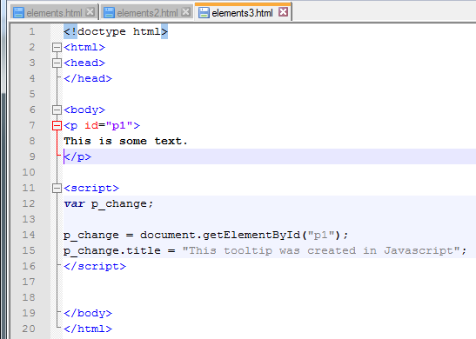
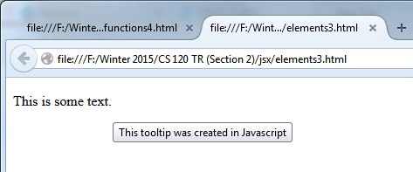
Accessing and Changing Elements (3)
Example: Changing (adding) the tooltip in a paragraph

Slide 44
Accessing and Changing Elements (4)
Every element is accessible through the DOM
Useful elements
Img
Table

Slide 45
The Img Element (DOM)
You can change things “on the fly” (at runtime) though the DOM.
Img element has many attributes
Alt Fallback text
Src Picture source (change the image)
Width, Height
useMap Add a map
complete Check to see if image has loaded (true if loaded)

Slide 46
Table Element (DOM)
Attributes
Caption change the caption
Rows returns all the rows in a table
Function
insertRow(index) insert a row
deleteRow(index) delete a row

Slide 47
Events
So far all our javascript has run immediately during runtime
What if we want to have things run at certain times?
We can set scripts to run when special things happen, such as button clicks!
Called events
Many many events

Slide 48
Events (2)
Events are set to occur after many particular actions
Button click (onclick)
The mouse moves over something (onmouseover)
Whenever the event happens, it can trigger javascript code!
Do this by setting assigning a function to the event!
How do we do this?!? Inline javascript!

Slide 49
Inline Javascript
Calls code inside a tag during the element’s event!
When the event occurs, the javascript inside is called
(Should just be a function inside the inline javascript)

Slide 50
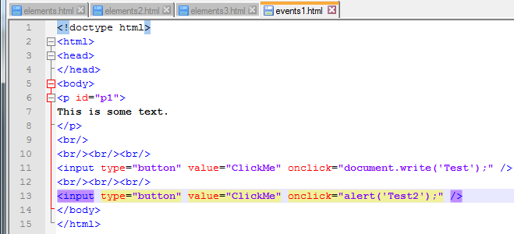
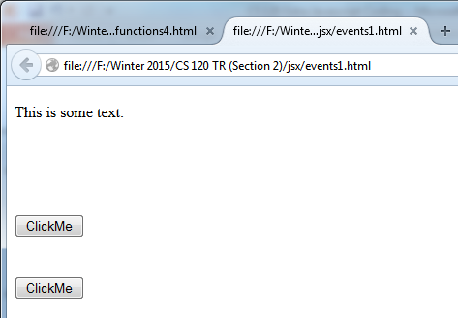
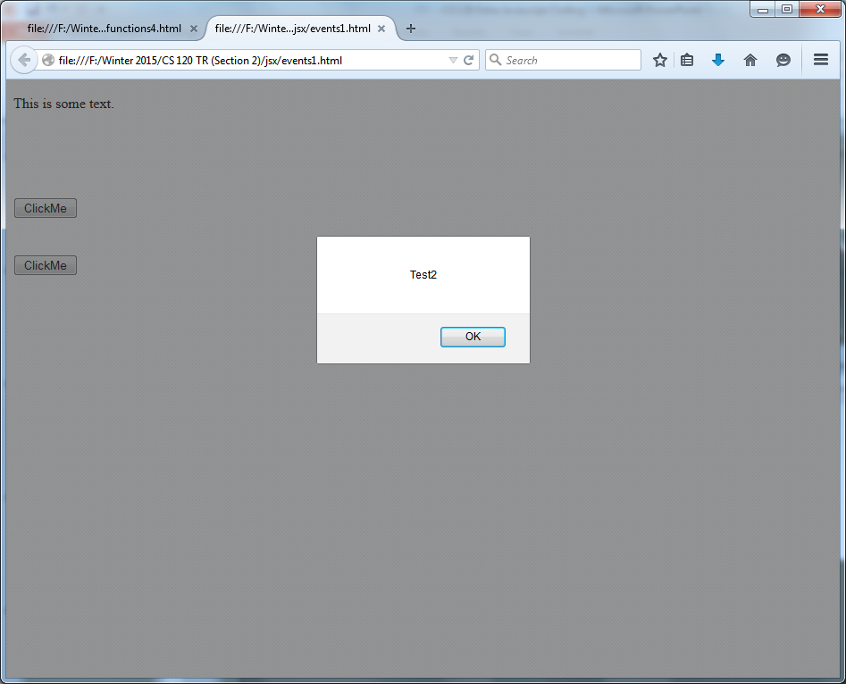
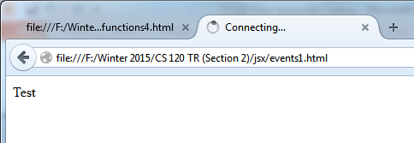
Inline Javascript (2)
Example: Pop up windows and text
ClickMe1:
ClickMe2:

Slide 51
Inline Javascript (3)
You can always use inline javascript to call your own functions!
Good luck!

